Slide 2
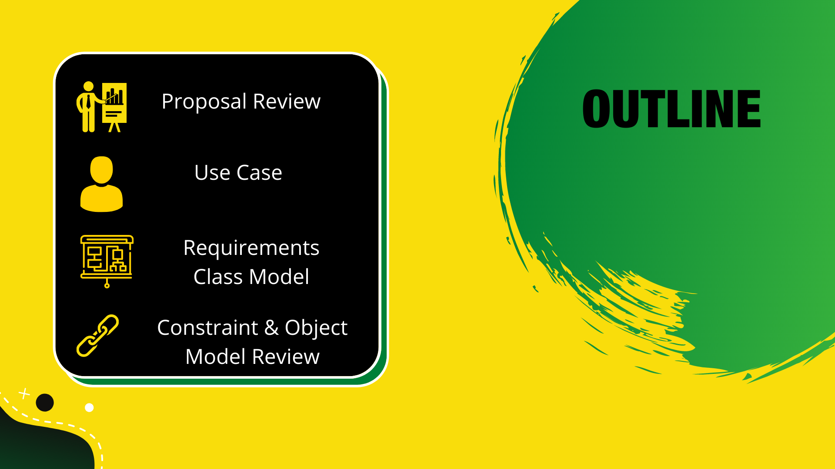

Slide 3




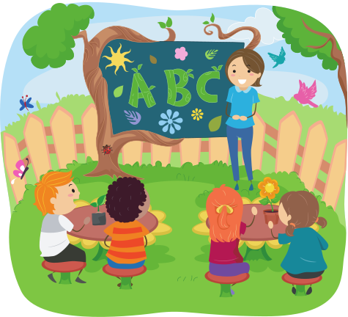


We Propose:
TutorJA
Supplimenting the Traditional Learning Experience

Slide 4




EDUCATION FOR THE FUTURE
Bridging the gap through technology

Slide 5



Connecting
Who need:
Face-to-Face One-on-one Tutoring
Face-to-Face Small Group Tutoring
Online One-on-one Tutoring
Students
(K3-Grade11)
Online Small Group Tutoring
Tutors

Slide 6
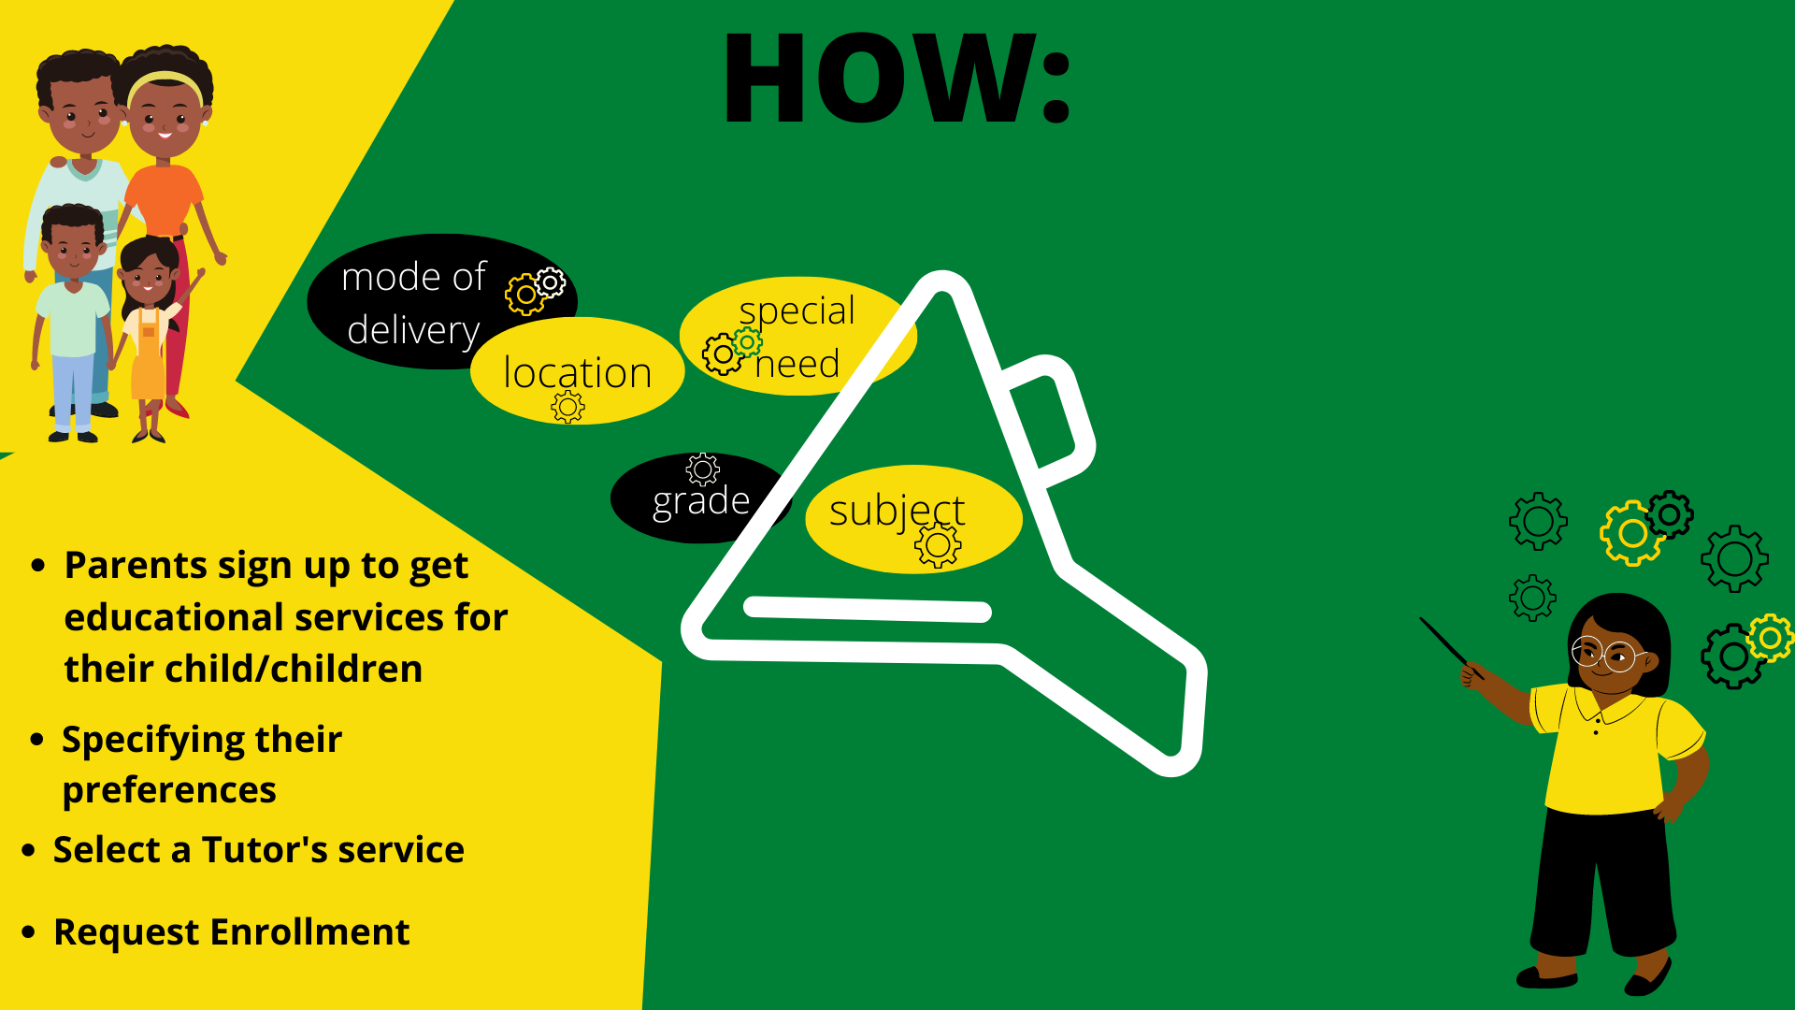

Slide 7





Use Case Model

Slide 8
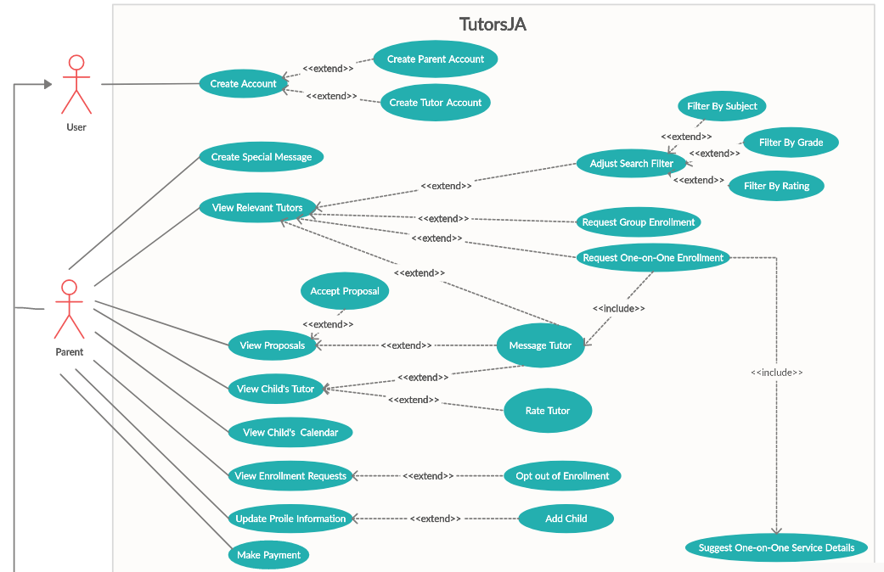

Slide 9
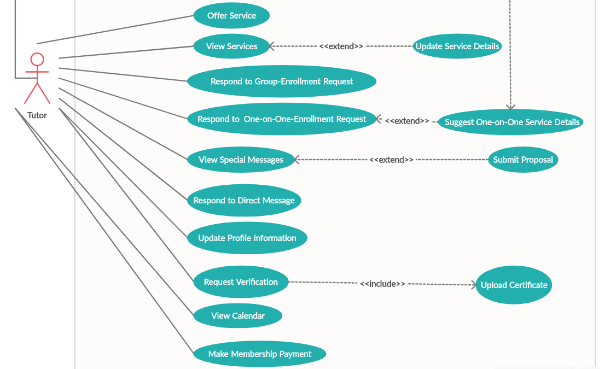

Slide 10



REQUIREMENT CLASS MODEL

Slide 11
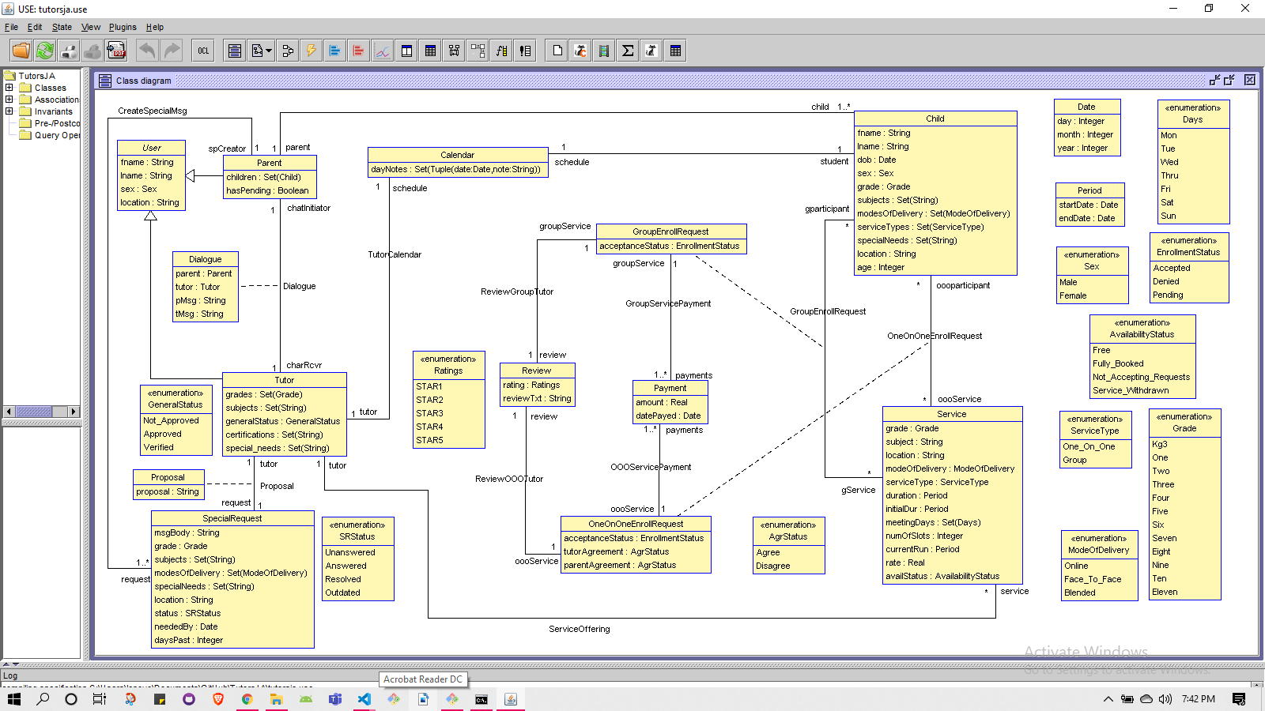

Slide 12

CONSTRAINTS
&
OBJECT MODEL REVIEW

Slide 13


Constraints Overview
If the mode of delivery is online then there is no meet location
A child must have a minimum age of 5 and a child must be below 19 years of age
inv :
self.modeOfDelivery = ModeOfDelivery::Online implies self.location = null
end
context Child inv ageFiveToNineteen:
self.age>= 5 and self.age < 19
end
context Child inv ageFiveToNineteen:
self.age>= 5 and self.age < 19
end

Slide 14
Constraints Overview
Only Tutors who are approved may offer service
A parent may review a tutor only after rating them
context Tutor inv mustBeApproved:
self.service->size()>0 implies self.generalStatus = GeneralStatus::Approved
end
context Parent inv mustRateThenReview:
self.rate = null implies self.review = null
end

Slide 15
Constraints Overview
A one-on-one enrollment request must be for a service with type "One-on-One"
A group enrollment request must be for a service with type "Group"
inv :
oooService.serviceType = ServiceType::One_On_One
end
inv :
self.gService.serviceType = ServiceType::Group
end

Slide 16
OBJECT MODEL REVIEW

Slide 17
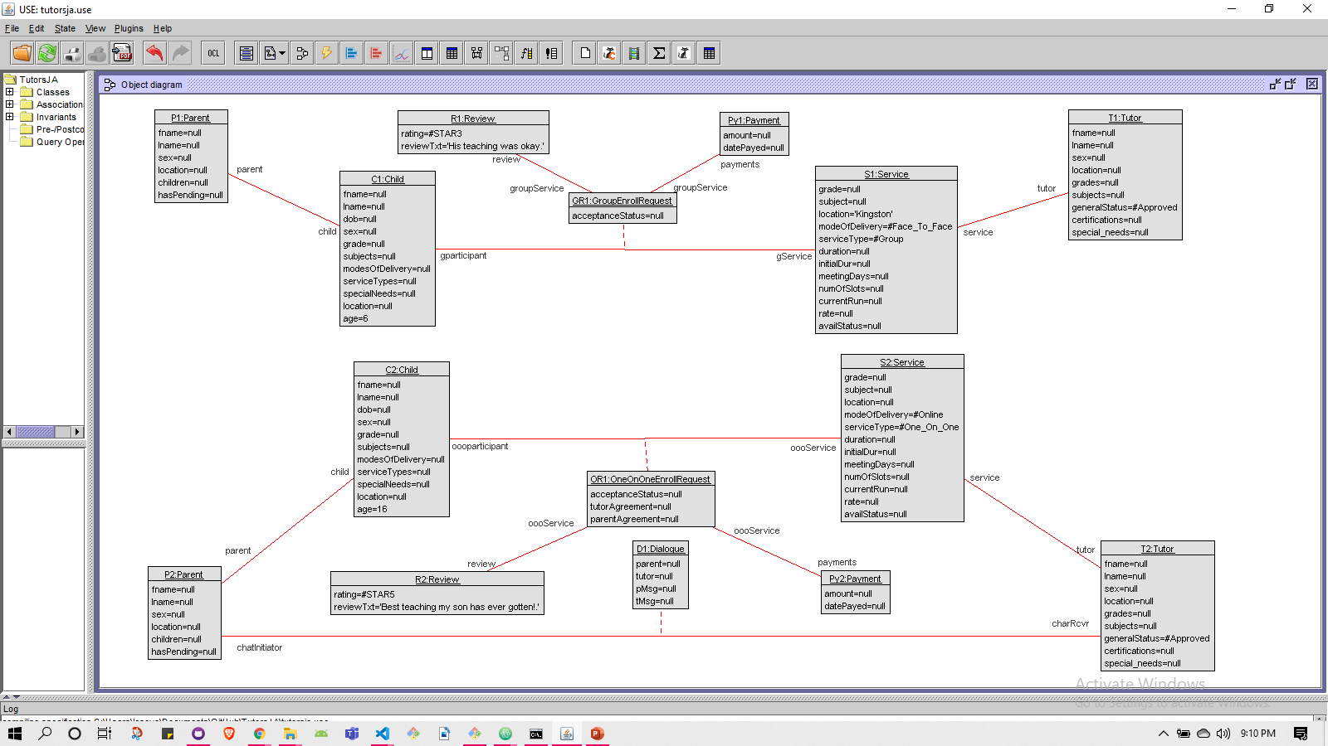
Notes:
Model showing adherence to constraints

Slide 18
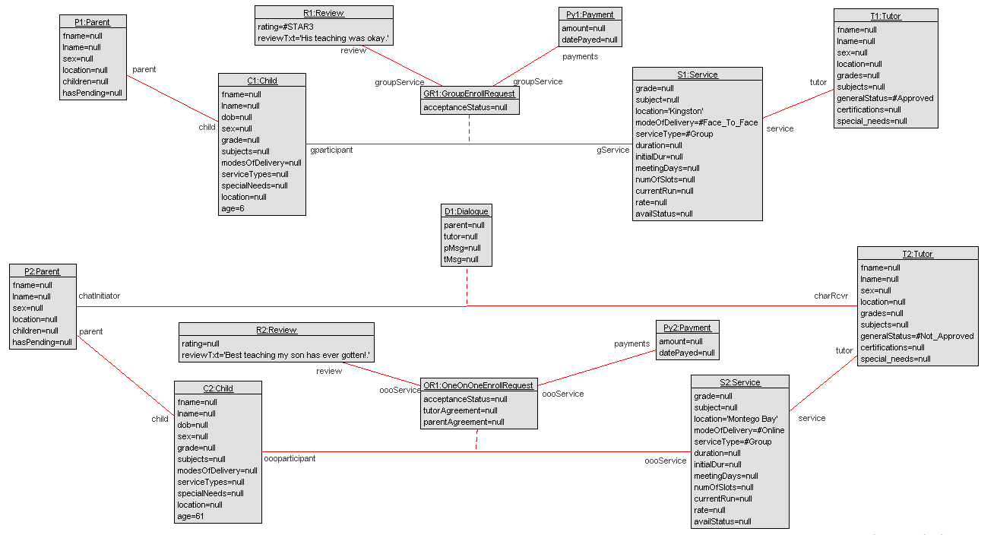

Slide 19

Demo

Slide 20





